Slide 1
Grocery shop management system
Welcome to

Slide 2
How it workes
This software is used to maintain datas of Customer ,product,worker of grocery shop

Slide 3
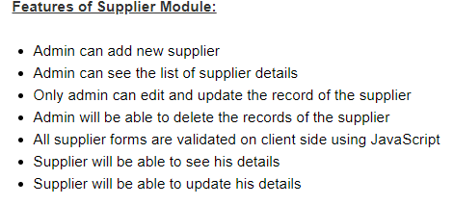

Slide 4
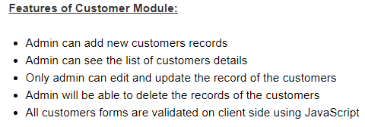

Slide 5
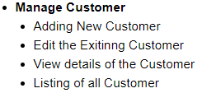
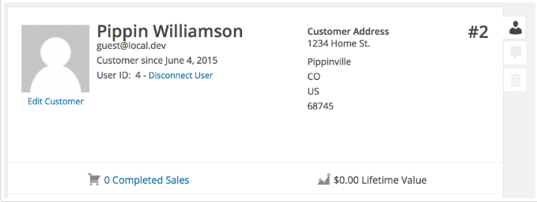

Slide 6
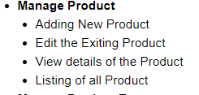

Slide 7
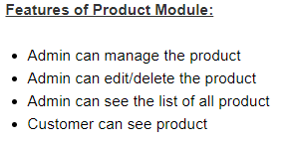

Slide 8
